Slide 1
Lesson objective
Title: Topic review
Aim:
Write expressions involving indices
Evaluate powers of 10
Plan:
Review
  Writing expressions
  indices
Indices and expressions
Evaluating
Need whiteboards

Slide 2

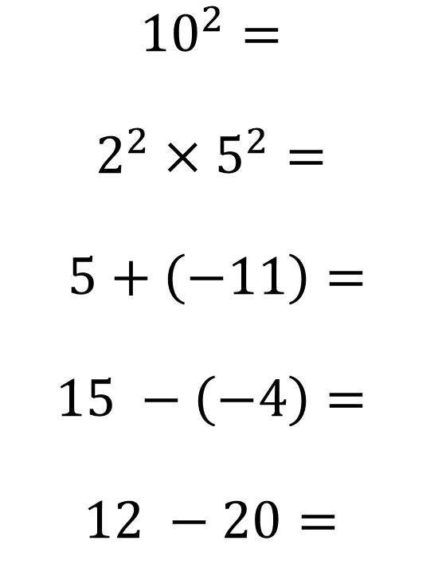
Quick maths
$${10}^{2}=$$
$$2^{2}×5^{2}=$$
$$5+\left(−11\right)=$$
$$15 −\left(−4\right)=$$
$$12 −20=$$
a = 3, b = 8
a + b =
4b – a =
$$\frac{ab}{6}=$$
Write an expression
K is multiplied by 8 and 3 is added
There are d students in a class, but 9 are away.

Slide 3

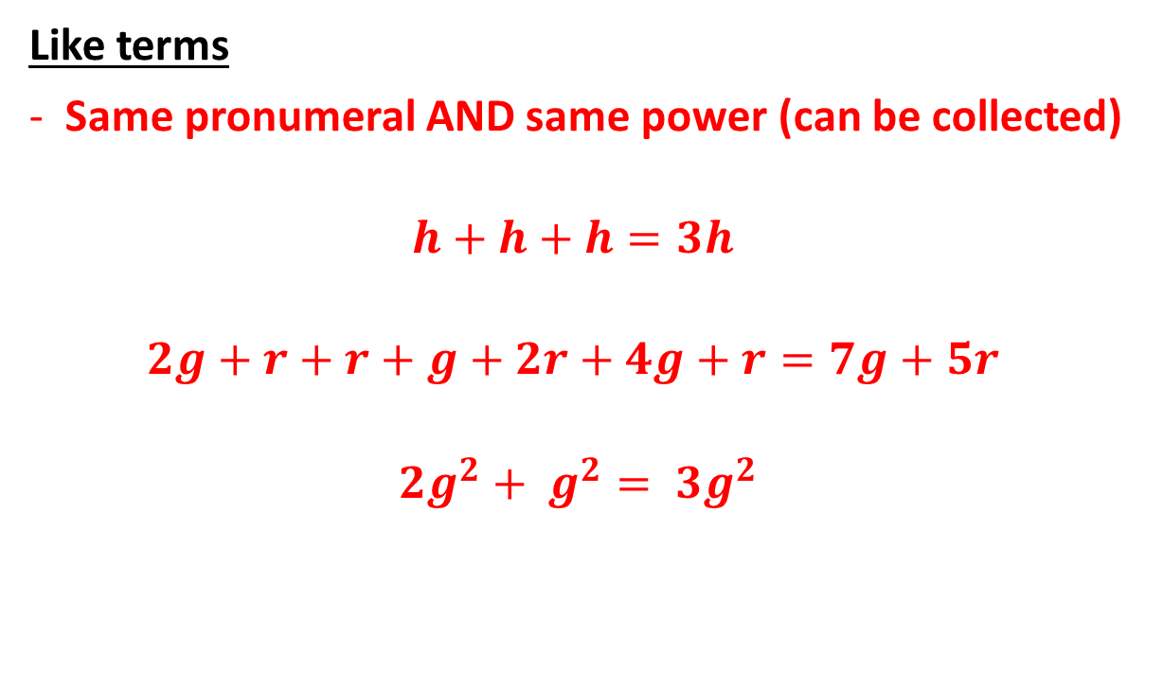
Terminology
Like terms
Same pronumeral AND same power (can be collected)
$$h+h+h=3h$$
$$2g+r+r+g+2r+4g+r=7g+5r$$
$${2g}^{2}+ g^{2}= {3g}^{2}$$
3g + 3h
5 + h
$${2d}^{2}+d$$

Slide 4







Review
Like terms
Same pronumeral AND same power (can be collected)
Which of the following is NOT a like term?
$$4f$$
$$f$$
$$−2f$$
$$−7f$$
$$10f$$
$$2fg$$
$${2f}^{2}$$

Slide 5
Writing expression
The perimeter of a shape is the total length of the boarder forming the shape.
E.g., the perimeter of this square is….
5cm

Slide 6
Writing expression
Expressions are used when we don’t know the value of something.
E.g., the perimeter of this square is….
2g

Slide 7
Perimeter of rectangles
2g + f
2f
3f +1
5g + 2f
5g +2
2g

Slide 8
Whiteboards
Write an expression for the perimeter of this square:
3d + 1

Slide 9
Whiteboards
Write an expression for the perimeter of this shape:
3h
5h + 4

Slide 10
Whiteboards
Write an expression for the perimeter of this shape:
5g
2g + 2

Slide 11
Whiteboards
Write an expression for the perimeter of this shape:
3f + g
2f + 3g

Slide 12
Whiteboards
Write an expression for the perimeter of this shape:
The perimeter of this rectangle is 4 times it’s height….
H

Slide 13
Individual practice
Page 215
Questions:
1 – 3 and 7 – 10 and 12
Challenge question 14

Slide 14

4 types of power problems
Expanding indices
Simplifying
How to say
Evaluating
$5^{4}$
$3 ×3 ×3 ×3 ×3$
$9^{12}$
$2^{4}=$

Slide 15
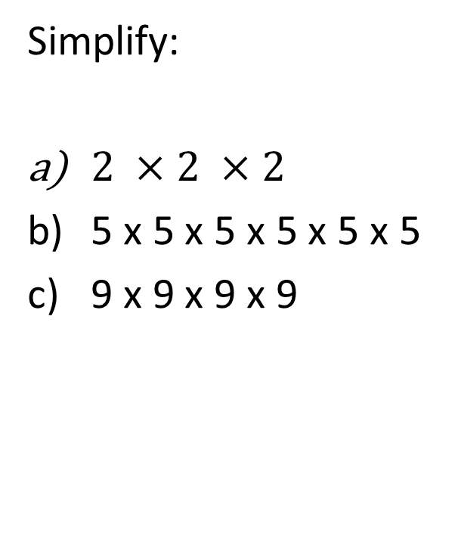
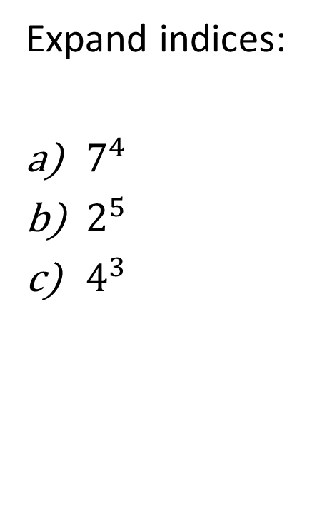
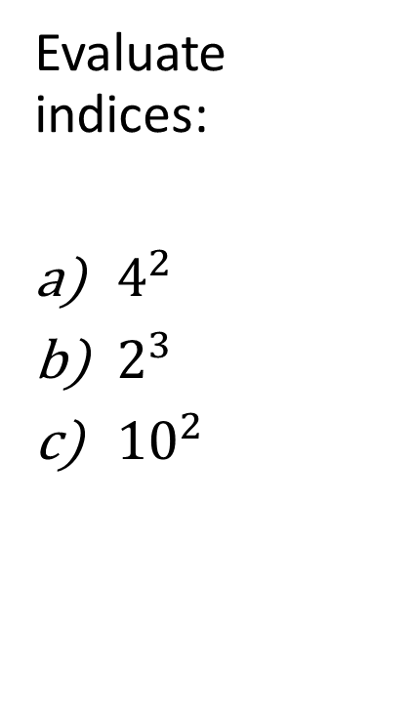
Whiteboards
Expand indices:
$7^{4}$
$2^{5}$
$4^{3}$
Simplify:
$2 ×2 ×2$
5 x 5 x 5 x 5 x 5 x 5
9 x 9 x 9 x 9
Evaluate indices:
$4^{2}$
$2^{3}$
${10}^{2}$

Slide 16
Expressions with indices
B and A grade level questions:
THINK: how could I write this in numbers?
Sam started with 4 hats, every year the number of hats doubles. So, after 2 years Sam has 8 hats, after 3 year = 16 hats. How many hats will Sam have after 7 years?
What does this look like just using numbers?

Slide 17
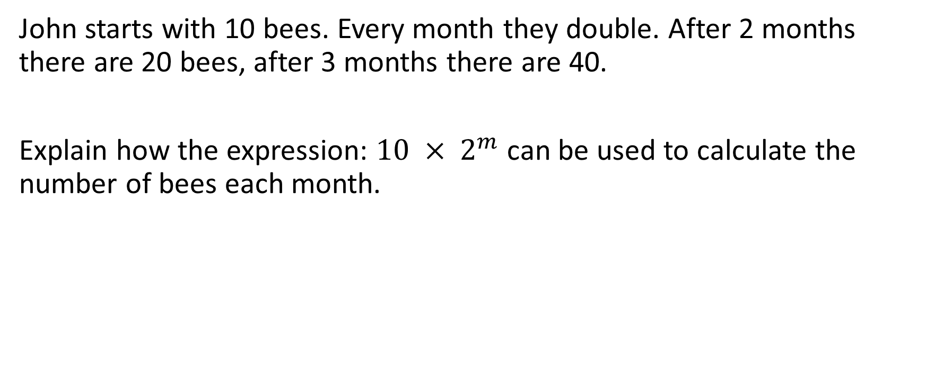
THINK: what do the numbers represent?
John starts with 10 bees. Every month they double. After 2 months there are 20 bees, after 3 months there are 40.
Explain how the expression: $10 × 2^{m}$ can be used to calculate the number of bees each month.

Slide 18
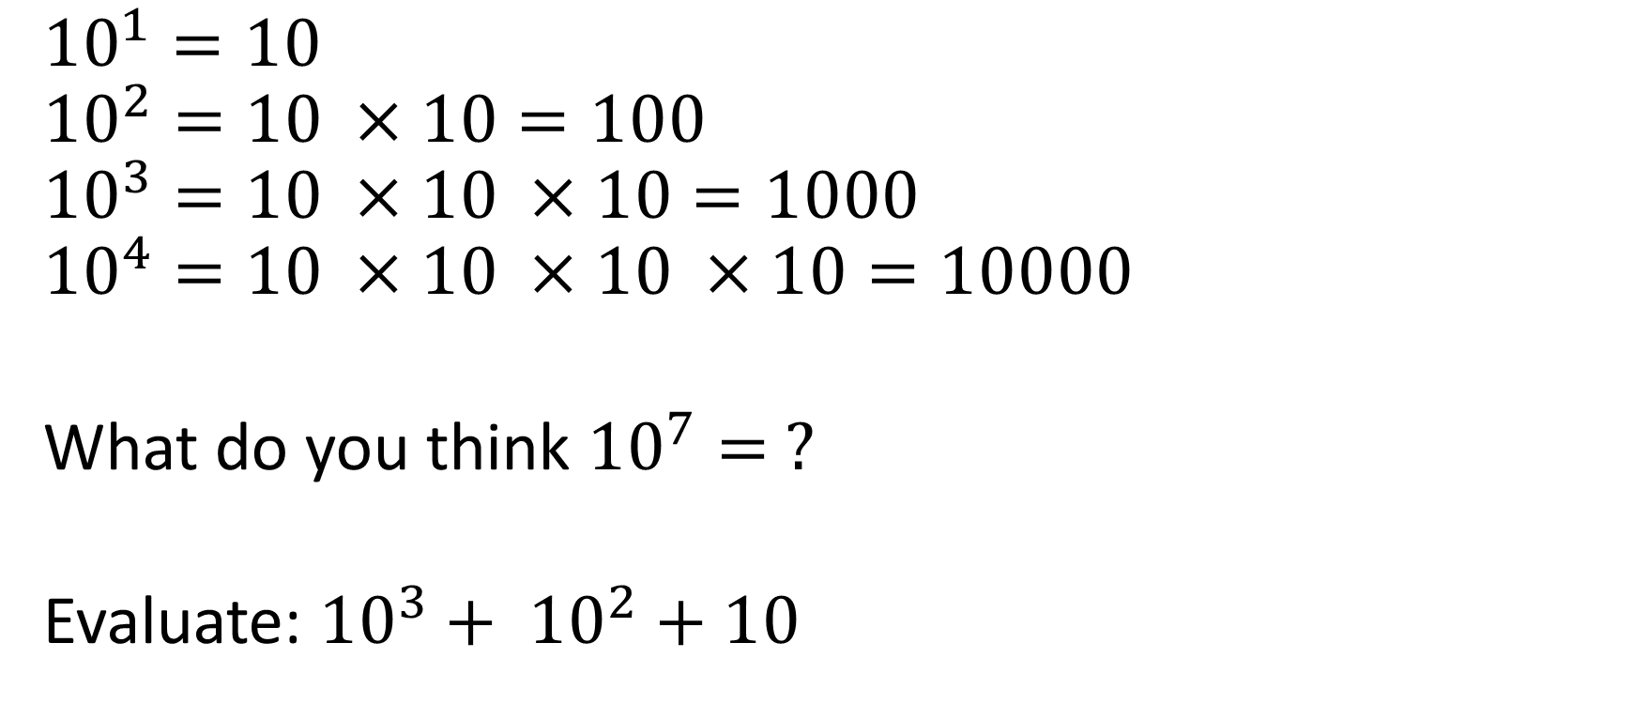
Powers of 10
$${10}^{1}=10$$
$${10}^{2}=10 ×10=100$$
$${10}^{3}=10 ×10 ×10=1000$$
$${10}^{4}=10 ×10 ×10 ×10=10000$$
What do you think ${10}^{7}= ?$
Evaluate: ${10}^{3}+ {10}^{2}+10$

Slide 19
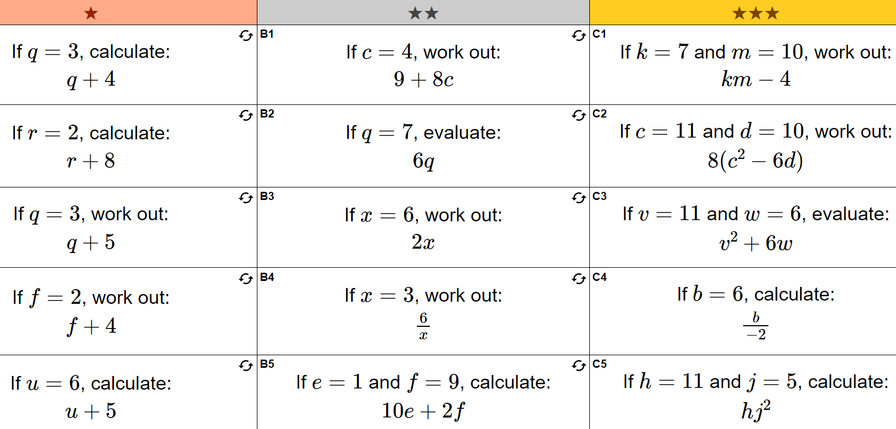
Substitution practice

Slide 20
